Slide 1

Department of Information Technology
Session 2025-25
Title selection seminar on
Deepfake Image Detection
Presented By Group No: 11
Mr. Ashutosh Dekate (Roll no:141)
Mr.Bhagyesh Nand (Roll no:144)
Mr.Kartik Nagrale (Roll no:154)
Mr.Sumedh Bhagat (Roll no:167)
Guided By
Dr.Nisha Wankhede
1
Notes:
1

Slide 2
Contents
Abstract
Introduction
Problem Definition
Aim & Objectives
Literature Survey
Patent Search
Research Gap
Proposed Methodology
Hardware Software Requirement
How it is useful for society
References

Slide 3
Abstract
Deepfake technology creates highly realistic but manipulated images, posing threats like misinformation and identity theft.
This project develops a deepfake image detection system using machine learning, specifically convolutional neural networks (CNNs), to identify inconsistencies in features, lighting, and textures. A dataset of real and deepfake images is used for training and evaluation.
The system will be optimized for accuracy that can be integrated into platforms to combat deepfake misuse, promoting trust in digital media.
3
Deepfake Image Detection

Slide 4
Introduction
Deepfake technology poses serious challenges, including the spread of misinformation, where manipulated media distorts facts and influences public opinion, leading to trust issues in news and digital communication. It also raises significant privacy concerns, as individuals' images can be misused without consent for identity theft or reputational harm. Furthermore, deepfakes undermine authenticity, making it increasingly difficult to distinguish real content from fake, eroding trust in digital media. These issues highlight the urgent need for advanced tools to preserve integrity and authenticity in the digital age.
4
Deepfake Image Detection

Slide 5
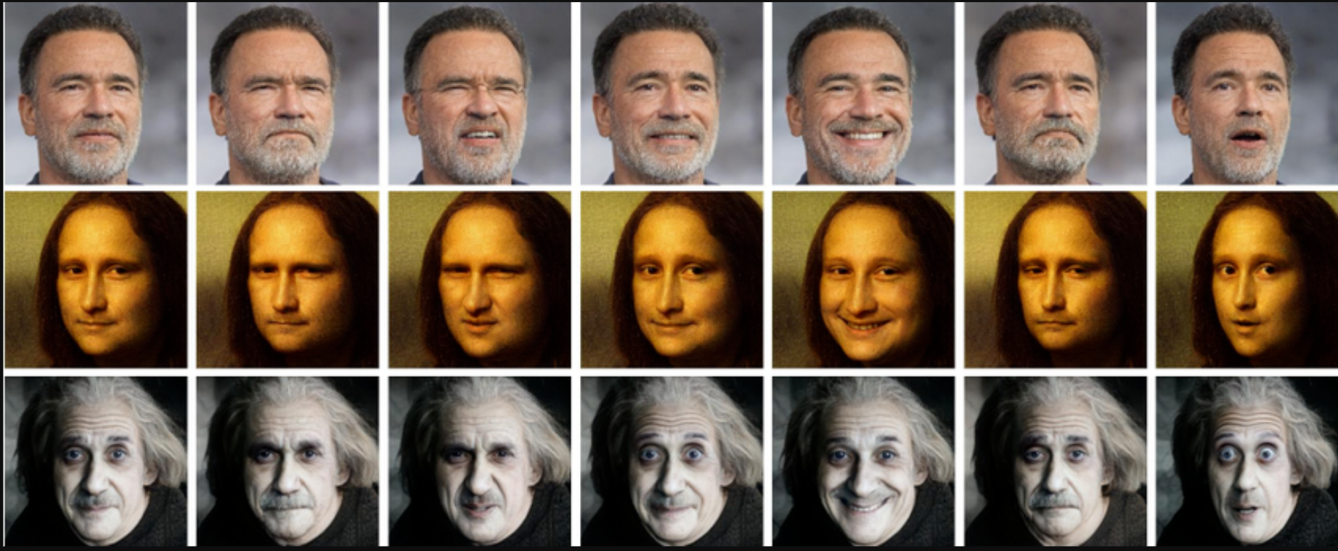
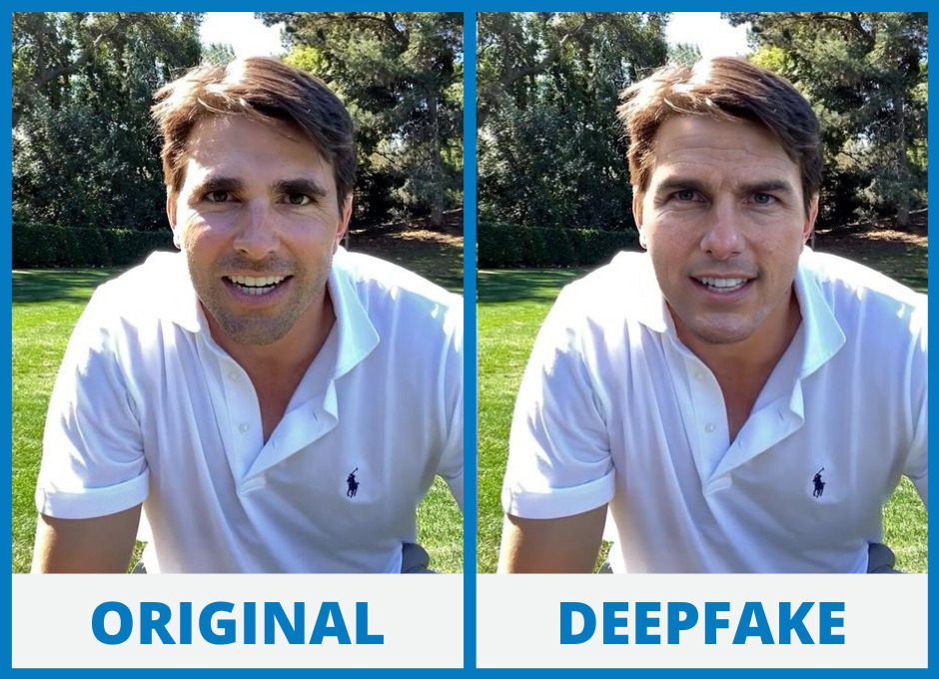
Introduction
5
Deepfake Image Detection

Slide 6
Problem Definition
The rise of deepfake technology has led to the creation of highly realistic yet manipulated media that poses significant societal challenges.
These include the spread of misinformation, breaches of privacy, and the erosion of trust in content authenticity.
Existing detection systems often struggle to keep up with the rapidly evolving methods used to generate deepfakes, resulting in inadequate protection against their misuse.
6
Deepfake Image Detection

Slide 7
Aim and Objectives
To address these challenges, there is a critical need for a robust and adaptive detection model capable of identifying deepfakes with high accuracy.
The proposed model combines Vision Transformers, Convolutional Neural Networks (CNNs), Meta-learning, Generative Adversarial Networks (GANs), and Graph Neural Networks (GNNs) to enhance detection capabilities.
By leveraging these advanced techniques, the system can adapt to evolving deepfake generation methods, reliably detect manipulated media, and uphold information integrity in digital platforms.
This solution is essential to mitigate the growing threats posed by deepfakes and ensure trust in digital communication.
7
Deepfake Image Detection

Slide 8
Literature Survey
Sr. No. | Title of the paper | Author | Year of Publication/ Publisher | Major observations/findings
1 | Fine-Grained Open-Set Deepfake Detection via Unsupervised Domain Adaptation | Xinye Zhou, Hu Han, Shiguang Shan, Xilin Chen | 01 January 2024 IEEE Transactions on Information Forensics and Security, Volume 19 | This study proposes an unsupervised domain adaptation method for fine-grained open-set deepfake detection. The approach focuses on adapting the detection model to new, unseen deepfake types without requiring labeled data from those categories.
2 | Exposing Deepfake Face Forgeries With Guided Residuals by Y. Zhang et al. | Zhiqing Guo, Gaobo Yang, Jiyou Chen, Xingming Sun | 2 May 2022 IEEE Transactions on multimedia, Volume 25 | This research introduces a method that utilizes residual-based features to preserve tampering traces while suppressing irrelevant image content. The guided residuals enhance the detection of subtle artifacts introduced during deepfake generation
8
Deepfake Image Detection
Notes:
8

Slide 9
Literature Survey
Sr. No. | Title of the paper | Author | Year of Publication/ Publisher | Major observations/findings
3 | Exposing Face Forgery Across Domains via Bi-Directional Adaptation by L. Wang et al | Qingxuan Lv, Yuezun Li, Junyu Dong, Sheng Chen, Hui Yu, Huiyu Zhou, Shu Zhang | 2024 IEEE TRANSACTIONS ON INFORMATION FORENSICS AND SECURITY, VOL. 19, | Proposed a bi-directional domain adaptation framework for cross-domain robustness.
4 | Enhancing Deepfake Detection With Diversified Self-Blending Images and Residuals | Ahmed Abul Hasanaath, Hamzah Luqman, Raed Katib, Saeed Anwar | 12 Jun 2024 SDAIA-KFUPM Joint Research Center for Artificial Intelligence | Introduced a Fake Blender module to generate diverse synthetic images, improving training data diversity
9
Deepfake Image Detection
Notes:
9

Slide 10
Literature Survey
Sr. No. | Title of the paper | Author | Year of Publication/ Publisher | Major observations/findings
5 | Using Graph Neural Networks to Improve Generalization Capability of the Models for Deepfake Detection | H She, Y Hu, B Liu, J Li, Chang-Tsun LiChang-Tsun Li | 2024 IEEE Transactions on Information Forensics and Security. Vol 19 | Represented images as graphs and employed Graph Neural Networks (GNNs) to detect deepfake manipulations.
10
Deepfake Image Detection
Notes:
10

Slide 11
Patent Search
Sr. No. | Title of the paper | Author | Year of Publication/ Publisher | Major observations/findings
1 | Deepfake video detection system and method | Jung-Shian LII-Hsien LiuChuan-Kang LiuPo-Yi WuYen-Chu Peng | 2022-11-29 United States Patent | The present disclosure relates to facial recognition, and in particular to a system and method of detecting changes in the state of human eyes in a video, quantifying the behavior of the eye features based on time using deep learning, and then integrating statistical models to determine whether the video has been faked or altered.
2 | Adaptive Meta-Learning for Robust Deepfake Detection: | Dinesh Srivasthav P, Badri Narayan Subudhi | 2022 India Patent | This paper addresses the challenges of deepfake detection, by proposing meta-learning algorithm that enhances model performance.
11
Deepfake Image Detection
Notes:
11

Slide 12
Patent Search
Sr. No. | Title of the paper | Author | Year of Publication/ Publisher | Major observations/findings
3 | Methods and systems for detecting deepfakes | Michael Morgan PriceMatthew Alan Price | 2024-04-16 United States Patent | A system for detecting synthetic videos includes a server, multiple weak classifiers, and a strong classifier. Weak classifiers are trained on real and synthetic videos to analyze distinct characteristics, detect irregularities, and generate predictions on whether a video is synthetic. The server collects these predictions and sends them to the strong classifier. The strong classifier, trained to analyze the weak classifiers' predictions, determines if the video is synthetic based on the aggregated results.
12
Deepfake Image Detection
Notes:
12

Slide 13
Research Gap
Issues:
Imbalance Between Real and Fake Samples: Existing datasets often have an imbalance between the number of real and deepfake samples. This imbalance can skew the performance of detection algorithms, making them less effective in real-world scenarios where deepfakes may be less prevalent.
Adaptation to Evolving Deepfake Techniques: As deepfake generation methods continue to evolve, many existing detection algorithms struggle to adapt. There is a need for research that focuses on creating adaptive models capable of identifying new and sophisticated deepfake techniques.
Need for Robust Models: Current models often struggle with overfitting, particularly when trained on limited data. There is a pressing need for more robust architectures that can maintain high accuracy while being less prone to overfitting.
Generalization to Unseen Data: Many models are trained on specific datasets and fail to generalize across various deepfake generation techniques.
13
Deepfake Image Detection
Notes:
13

Slide 14
Research Gap
Solution:
Deepfake Detection using CNN : Studies have used convolutional neural networks (CNNs) to detect deepfakes, achieving high accuracy rates
MesoNet for Deepfake Detection : The study proposes a deep-learning method called MesoNet, which utilizes compact convolutional neural networks to detect manipulated facial expressions with high accuracy
Face Forensics: Researchers have proposed face forensics methods to detect deepfakes, including analyzing facial expressions, eye movements, and skin texture
Deep Learning-based Detection: Deep learning-based methods, such as recurrent neural networks (RNNs) and long short-term memory (LSTM) networks, have been used to detect deepfakes
14
Deepfake Image Detection
Notes:
14

Slide 15
Proposed Methodology
Data Collection and Preprocessing
Collect a large dataset of real face images or videos from various sources, such as:
Publicly available datasets (e.g., FaceForensics++, Deepfake Detection Dataset)
Web scraping
Crowdsourcing
ViT Model Development
Implement a Vision Transformer (ViT) model using PyTorch or TensorFlow.
Train the ViT model on the real face images or videos.
Evaluate the ViT model on the validation set.
ML Libraries:
PyTorch or TensorFlow for building and training the ViT model
transformers library for pre-trained ViT models
GAN-Based Deepfake Detection
Implement a GAN-based deepfake detection model using PyTorch or TensorFlow.
Train the GAN-based model on the deepfake face images or videos.
Evaluate the GAN-based model on the validation set.
ML Libraries:
PyTorch or TensorFlow for building and training the GAN-based model
gan-lib library for GAN-related utilities
15
Deepfake Image Detection
Notes:
15

Slide 16
Proposed Methodology
Meta-Learning
1. Implement a meta-learning algorithm (e.g., Model-Agnostic Meta-
Learning (MAML)) using pytorch or tensorflow.
2. Train the meta-learning model on the deepfake face images or videos.
3. Evaluate the meta-learning model on the validation set.
ML Libraries:
- pytorch or tensorflow for building and training the meta-learning model
- learn2learn library for meta-learning algorithms
Hyperparameter Tuning and Model Deployment
1. Perform hyperparameter tuning for the ensemble model using optuna or hyperopt.
2. Deploy the ensemble model using tensorflow-serving or pytorch-serving.
16
Deepfake Image Detection
Notes:
16

Slide 17
Proposed Methodology
Data Collection and Preprocessing
GAN-Based Deepfake Detection
ViT Model Development
Meta-Learning
Hyperparameter Tuning and Model Deployment
17
Deepfake Image Detection
Notes:
17

Slide 18
Proposed Methodology
GAN-Generated Deepfakes: Addressing challenges posed by diverse datasets and ensuring reliable detection of previously unseen synthetic data.
Transformer-Based Architectures: Leveraging transformer models to maintain high accuracy across varied and complex datasets, ensuring consistency in detection.
Strategies to Enhance Generalization: Employing techniques like domain adaptation and transfer learning to improve model adaptability and performance across different domains.
Evaluating Robustness Against Emerging Threats: Ensuring the system's adaptivity to counter evolving deepfake generation techniques and emerging threats effectively.
18
Deepfake Image Detection
Notes:
18

Slide 19
Hardware/Software Requirement
Hardware Details : For a software, an effective hardware components are required in a computer.
Operating System: Windows 10 or newer, macOS, or Linux.
Memory: At least 2 GB of RAM is recommended for smooth operations.
Disk Space: Minimum 2 GB of free disk space for installing and functioning Jupyter Notebook and its dependencies.
Processor : Pentium IV 2.6GHZ or above
Hard disk Space: 512 GB
Software Details :To run a system efficiently, software must be installed.
Operating System: Windows 10 or above
Languages used: Python, Py-Libraries
Software used: Jupyter Notebook and Visual Studio code
And more
19
Deepfake Image Detection
Notes:
19

Slide 20
How it is useful for Society
Prevents Misinformation: Stops the spread of fake news and disinformation.
Protects Individuals: Shields people from identity theft, reputation damage, and fraud.
Safeguards Political Integrity: Prevents the use of deepfakes to manipulate elections or political narratives.
Supports Law Enforcement: Helps in identifying fake evidence in legal or criminal investigations.
Enhances Media Trust: Assures the authenticity of news and media content, maintaining public trust.
20
Deepfake Image Detection
Notes:
20

Slide 21
References
Zhiqing Guo, Gaobo Yang, Jiyou Chen, and Xingming Sun. 2023. Exposing Deepfake Face Forgeries With Guided Residuals. Trans. Multi. 25 (2023), 8458–8470. https://doi.org/10.1109/TMM.2023.3237169
Xinye Zhou, Hu Han, Shiguang Shan, and Xilin Chen. 2024. Fine-Grained Open-Set Deepfake Detection via Unsupervised Domain Adaptation. Trans. Info. For. Sec. 19 (2024), 7536–7547. https://doi.org/10.1109/TIFS.2024.3435440
Lv, Qingxuan & Li, Yuezun & Dong, Junyu & Chen, Sheng & Yu, Hui & Zhou, Huiyu & Shu, Zhang. (2024). DomainForensics: Exposing Face Forgery Across Domains via Bi-Directional Adaptation. IEEE Transactions on Information Forensics and Security. PP. 1-1. 10.1109/TIFS.2024.3426317.
https://patents.google.com/patent/US20210142065A1/en
https://patents.google.com/patent/US20220129664A1/en
P, Dinesh & Subudhi, Badri. (2024). Adaptive Meta-Learning for Robust Deepfake Detection: A Multi-Agent Framework to Data Drift and Model Generalization. 10.48550/arXiv.2411.08148.
21
Deepfake Image Detection
Notes:
21

Slide 22
Roles and Responsibility
Team Member Details | Roles and Responsibility
(Team Captain) – Bhagyesh Nand | Research Work
Sumedh Bhagat | Research Work
Kartik Nagrale | Research Work
Ashutosh Dekate
22
Deepfake Image Detection
Notes:
22

Slide 23
Plan of Action
Activity (2025) | Jan | Feb | March | April | May
Literature Survey | Working
Data Collection | Working
Data Preprocessing and ViT model development
GAN based and Meta Machine Learning Model
Parameter Tuning and Model development
Preparation of Project Report/Paper Writing
Paper publishing
Thank You…….
23
Deepfake Image Detection

Slide 24
Thank You…….
23
Deepfake Image Detection

